Slide 1
DATA STRUCTURES PROJECT
PROJECT TITLE: RESTAURANT MANAGEMENT SYSTEM
TEAM MEMBERS:
BUDDIGINA THARUN -019
DIVILI SATHVIK -025
ARIPIRALA SAI SRIVATHSAV -014
MOHIT CHIBADE -042
AKSHAT SINGHAL -006

Slide 2
PROJECT DESCRIPTION:
The clear description for the project is given in the form of Flow charts in the upcoming slides.
Platform used: Java (Eclipse IDE)
Concepts Used:
Singly Linked List functions
Insertion sort using Linked List
Queue using Linked List
Timers in Java
Inheritance in Java
Random in Java
File Handling

Slide 3
ADVANTAGES:
User- Friendly Execution
Food Ordering Made easy with several options left for customer.
Data Backup available.
LIMITATIONS:
Only Specified Admins can access and admins cannot add other persons. Change should be made in the .txt file.
Doesn’t display the token number of the customer in queue after 5 sec(tentative) of waiting.
Cannot delete food based on Food name.

Slide 4
RESTAURANT
MANAGEMENT SYSTEM
If entered Credentials match!
Food List Preview
Add food to the list
Customer
Ordering Required
Food
Exit
Delete food from the list
View Payments
Go to Previous Menu
Stepping
Out of Output
Automatically redirects to Previous Menu
View the completed Payments in one go.
Deletes food item based on the serial number.
Show the list of food items available for sale.
Adding food to the existing list
Login to Admin Panel

Slide 5
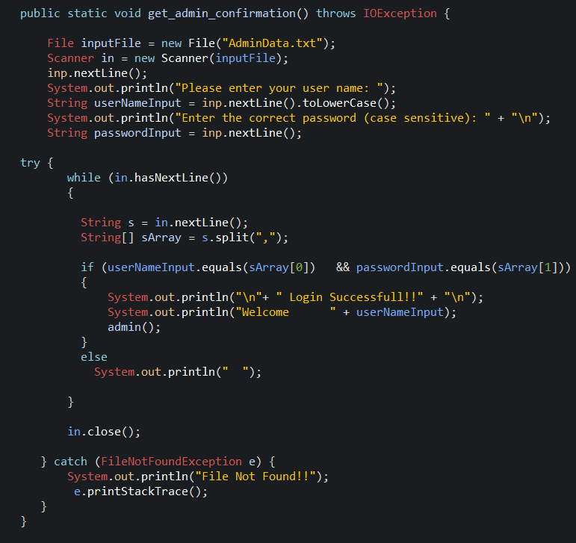
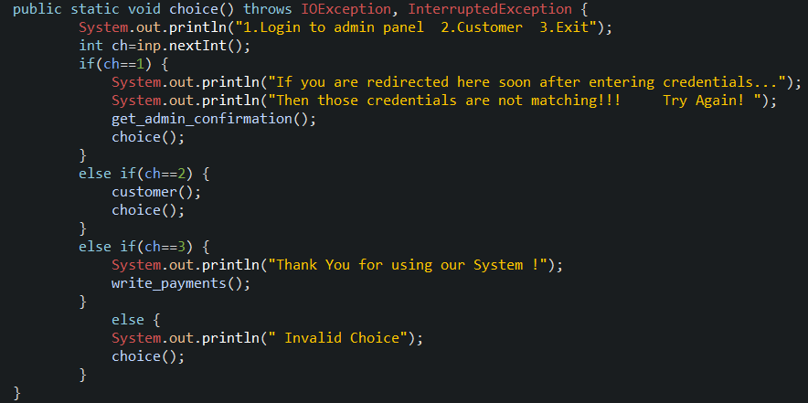
CODE SNIPPETS
RESTAURANT
MANAGEMENT SYSTEM
Login to Admin Panel

Slide 6
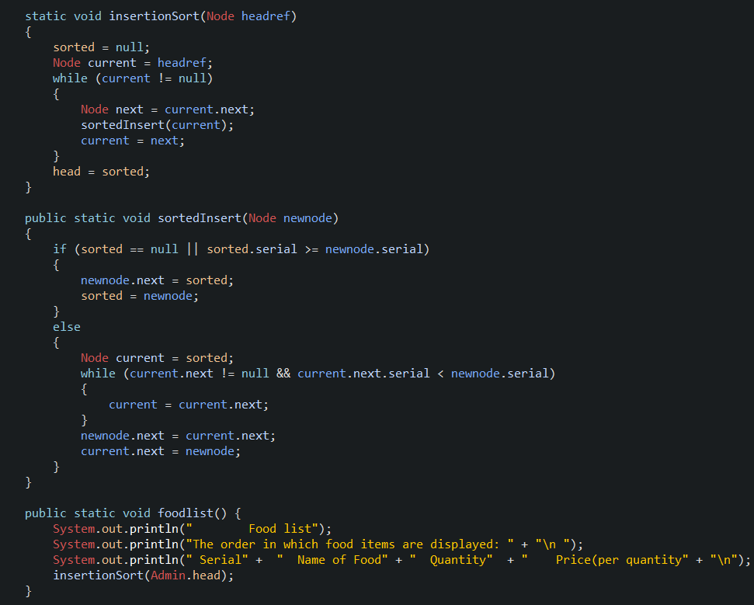
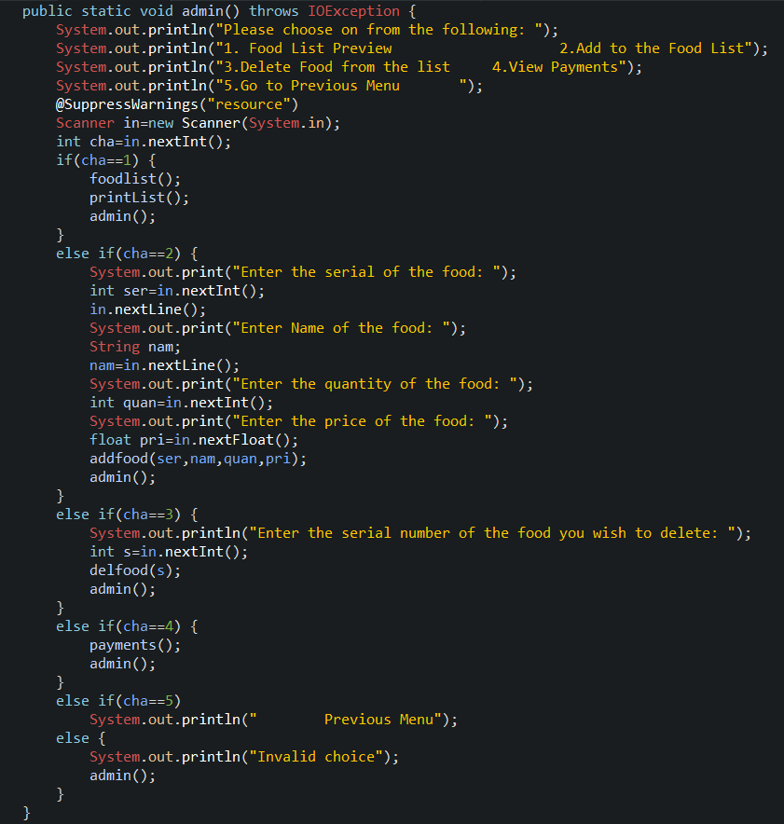
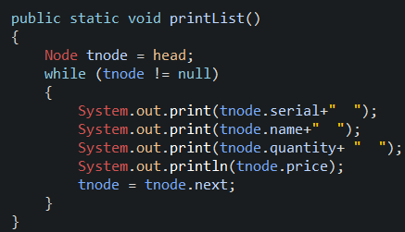
If entered Credentials match!
Food List Preview

Slide 7
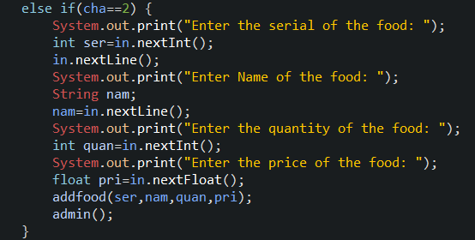
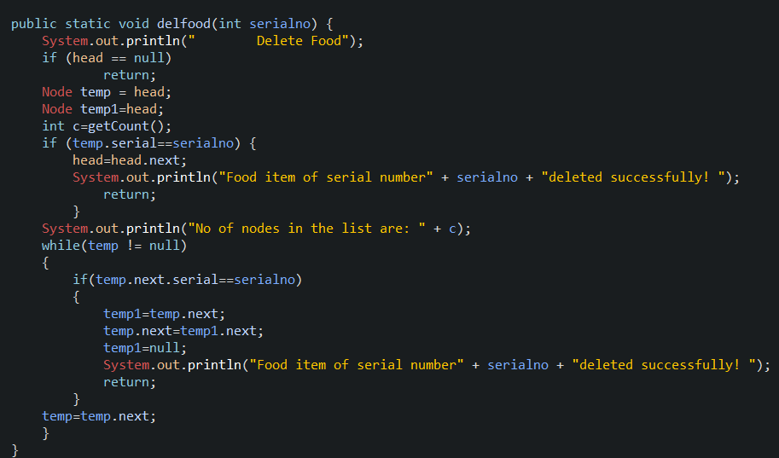
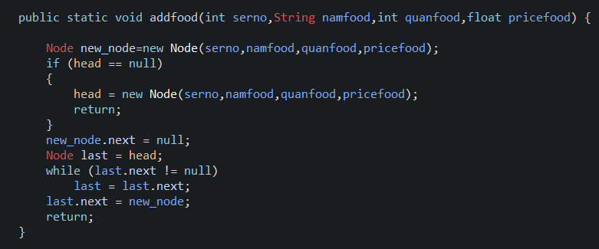
Add food to the list
Delete food from the list

Slide 8
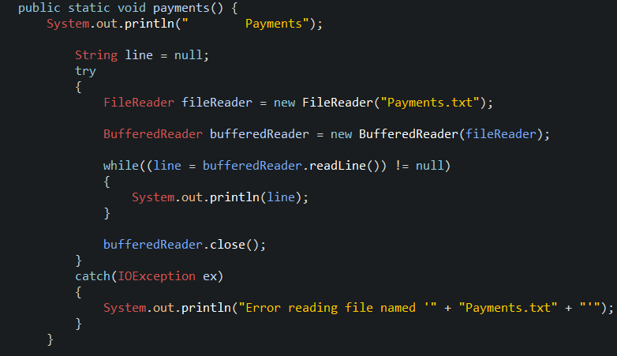
View Payments
Go to Previous Menu

Slide 9
Customer
Ordering
Required Food
Choice of Customer
Make changes to choice
Proceed with selection
Writing Payment to the database
If yes
If no
Proceed with payment
Proceed with payment
Customer choice change

Slide 10
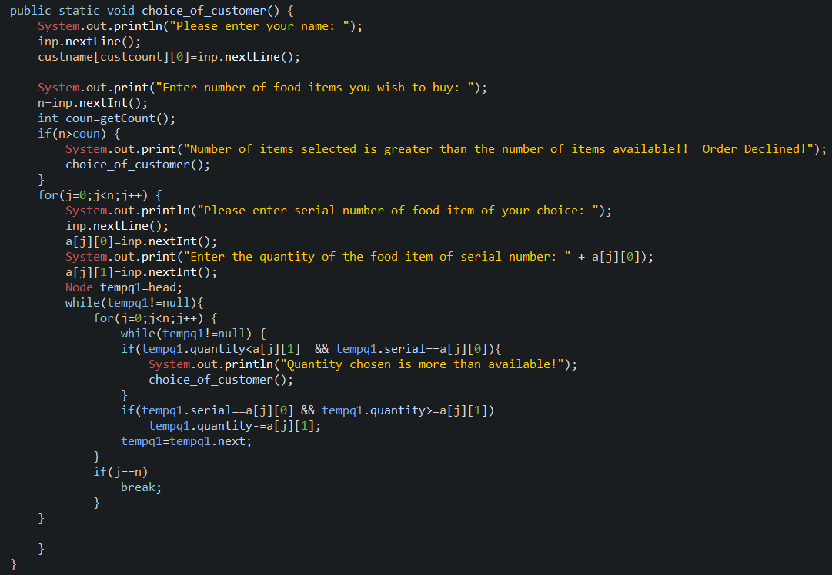
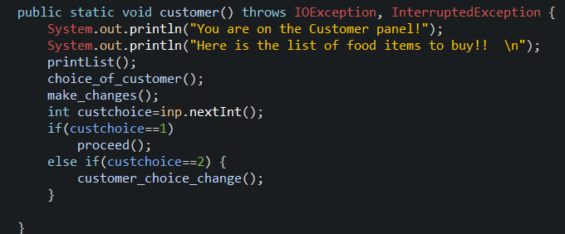
Customer
Choice of Customer

Slide 11
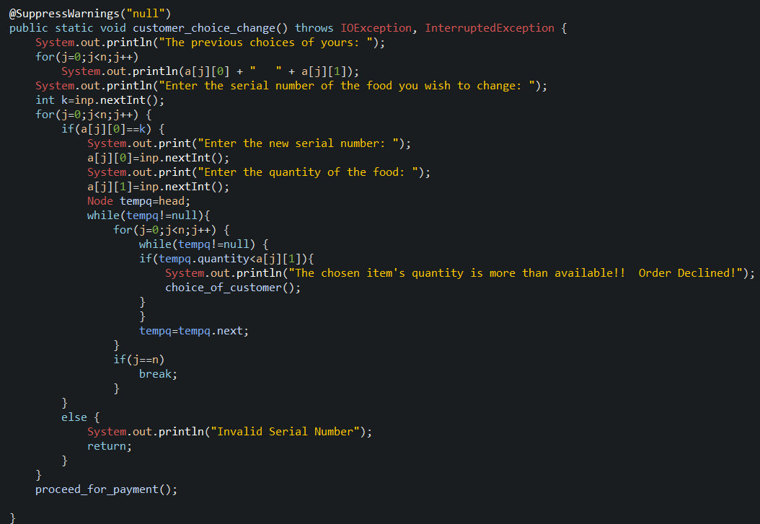
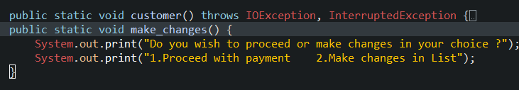
Make changes to choice
Customer choice change

Slide 12
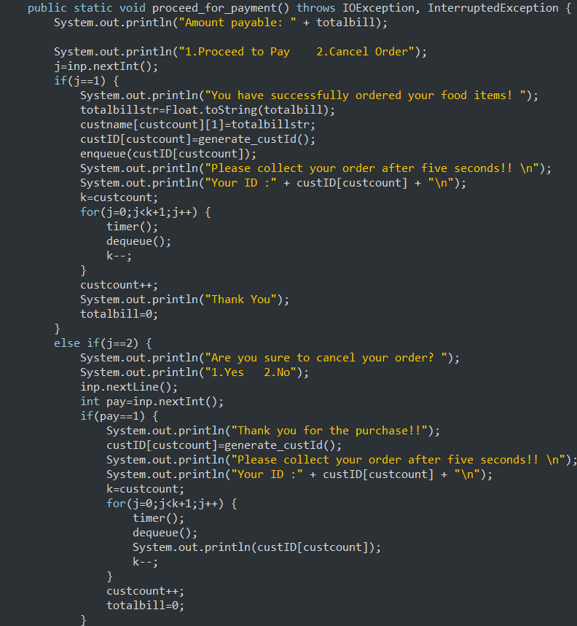
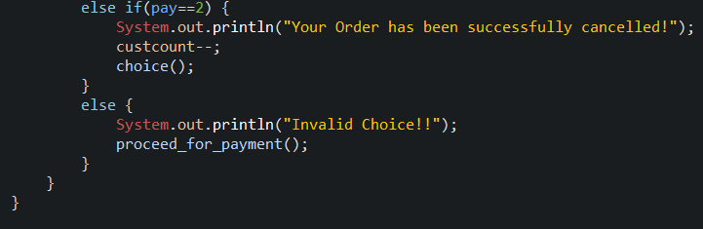
Proceed with payment

Slide 13
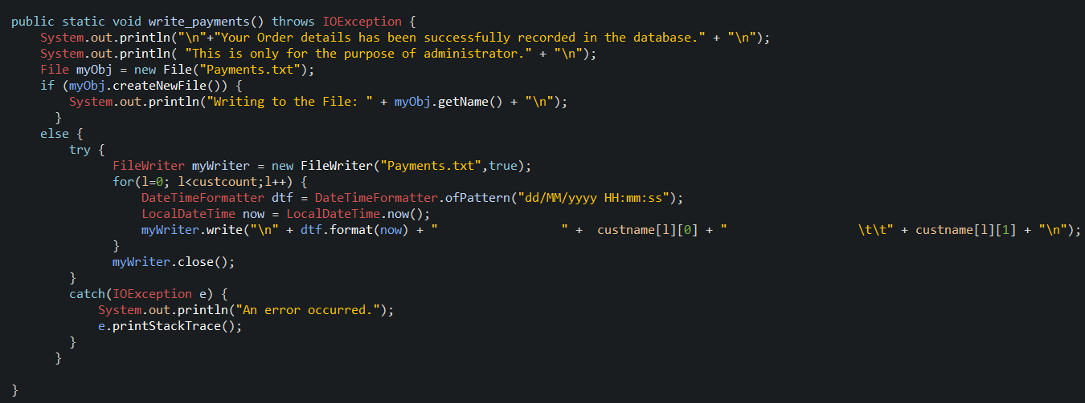
Writing Payment to the database

Slide 14
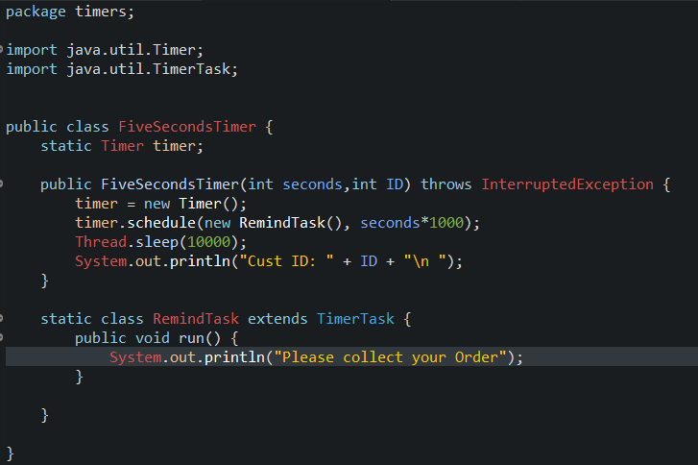
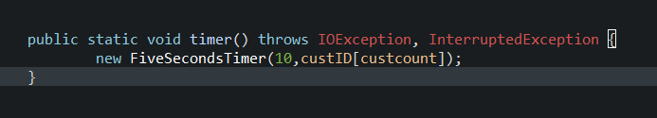
OTHER CODE SNIPPETS USED
TIMERS:

Slide 15
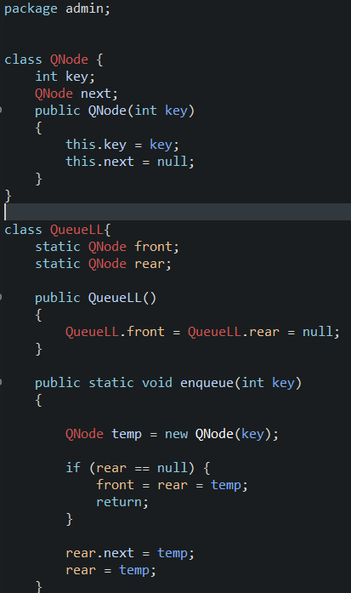
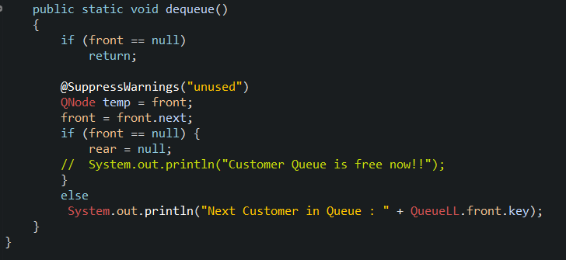
QUEUE
USING SLL

Slide 16
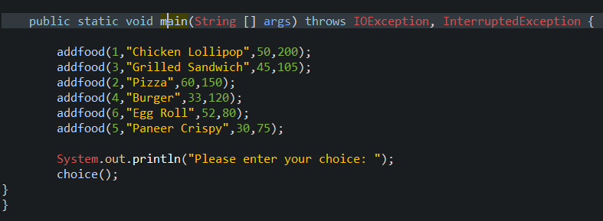
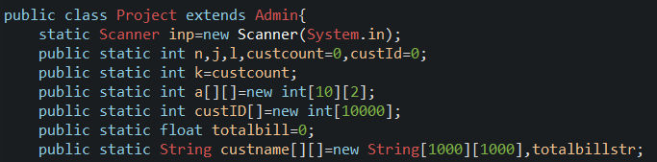
VARIABLES DECLARATION
MAIN FUNCTION

Slide 17
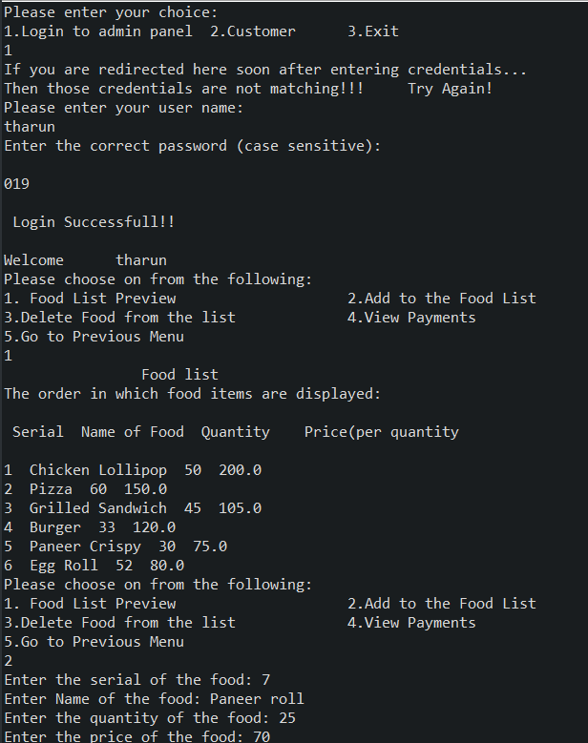
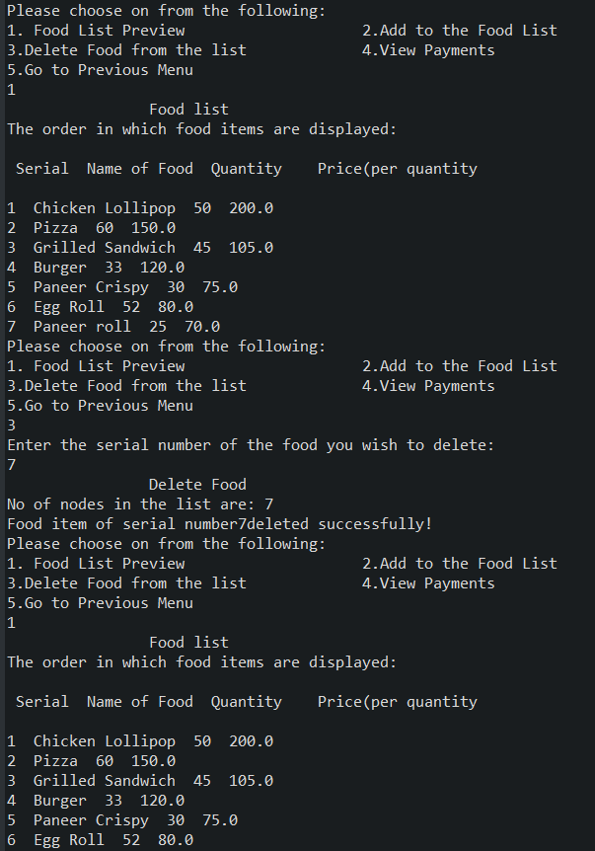
OUTPUT SCREEN SHOTS

Slide 18
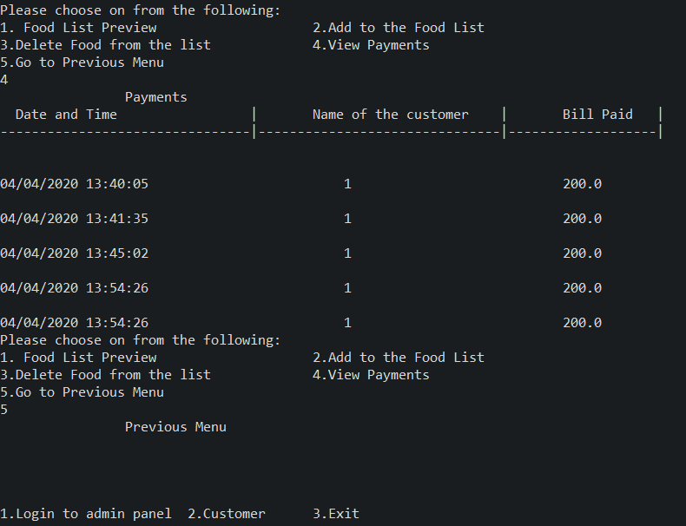

Slide 19
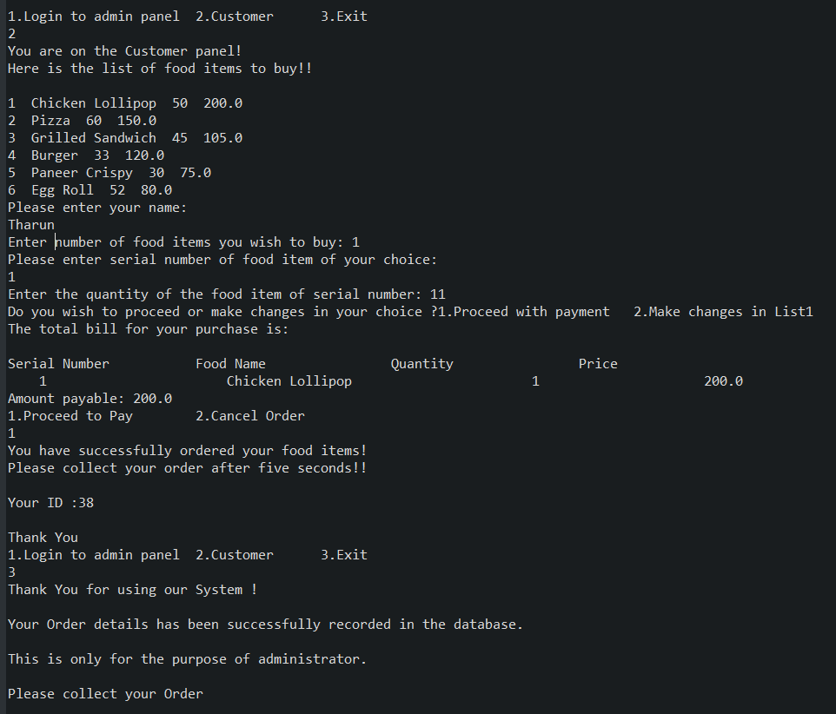

Slide 20
THANK YOU
VISIT AGAIN ☺

